Slide 1
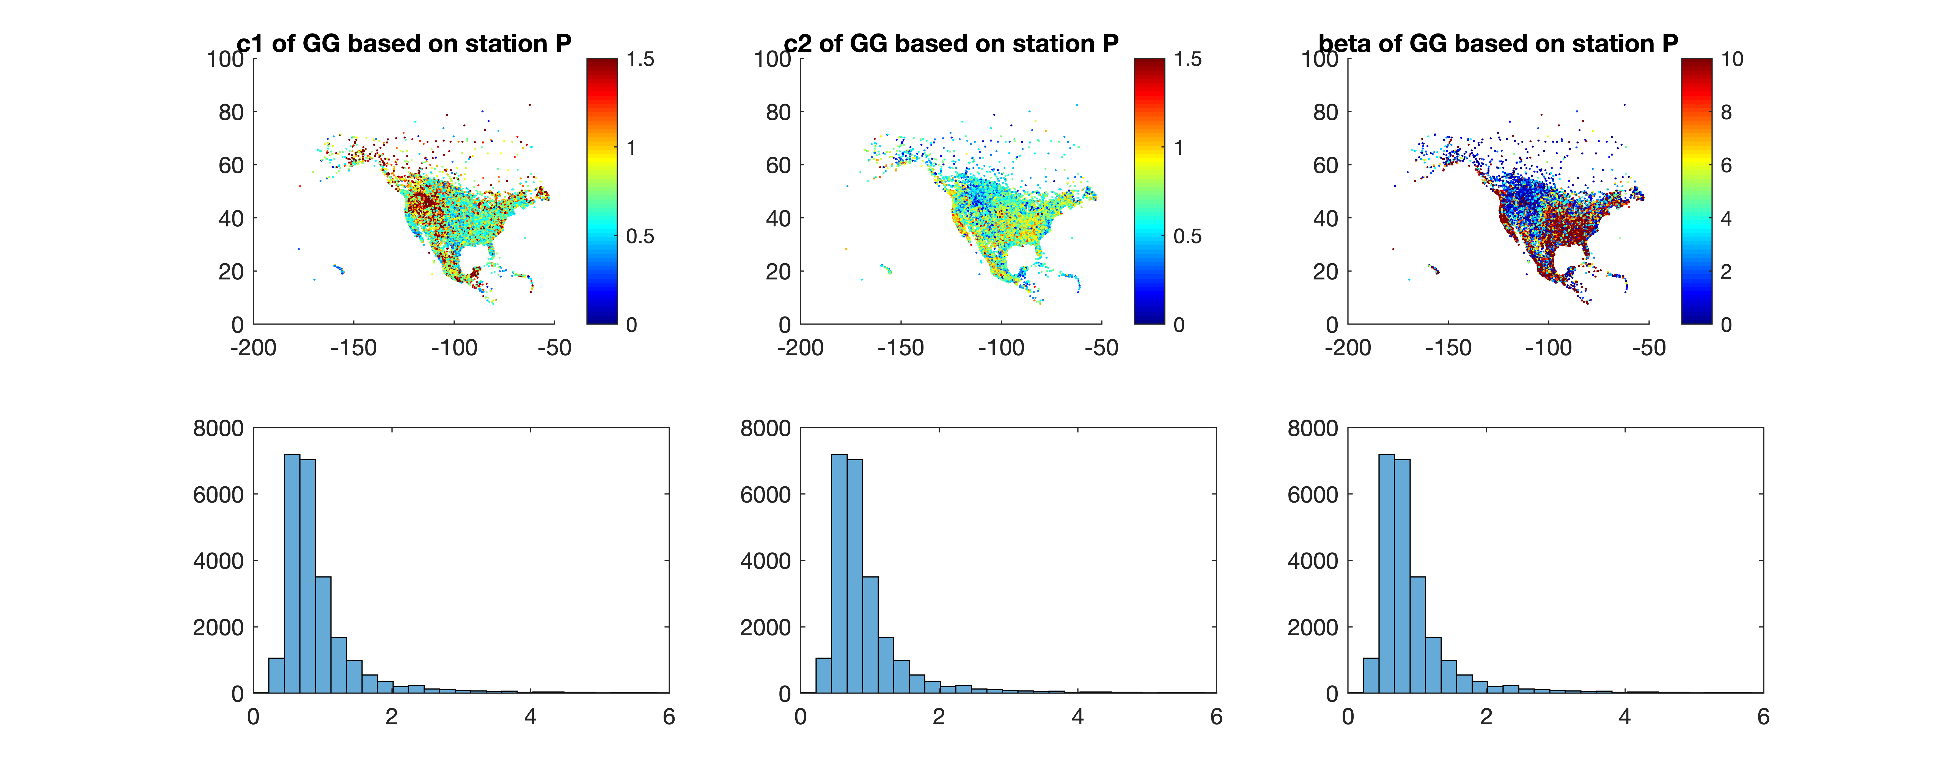
Generalized Gamma based on station data
Three parameters based on station precipitation (>= 0.1 mm)

Slide 2
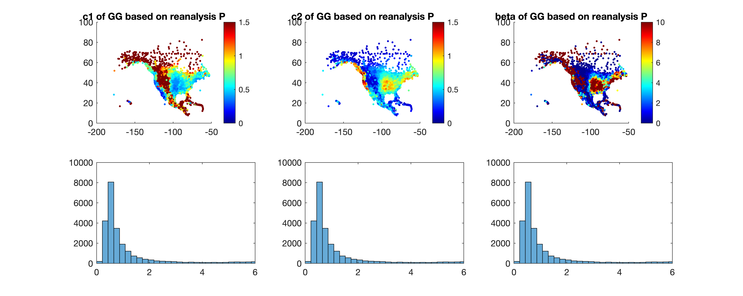
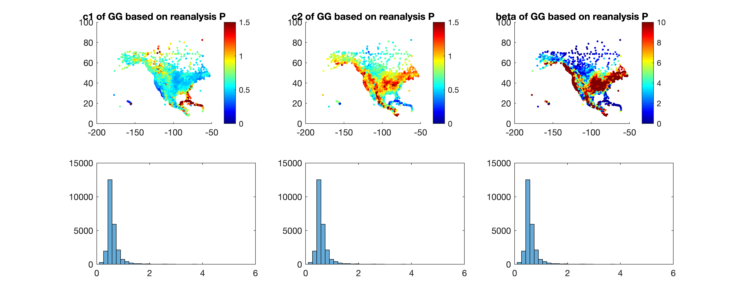
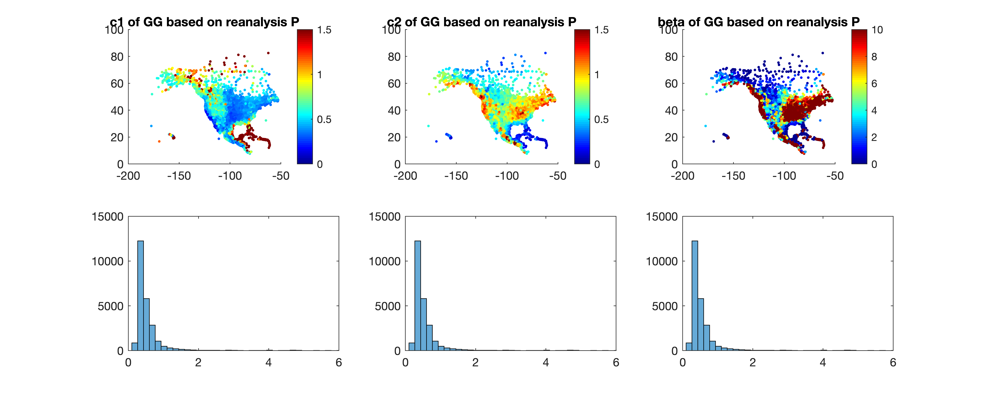
ERA5
Generalized Gamma based on reanalysis data
JRA55
MERRA2

Slide 3
Generalized Gamma:
Compensation between c1 and c2
Color: the objective function needing to be minimized
An incomplete check shows stations generally show this pattern.

Slide 4
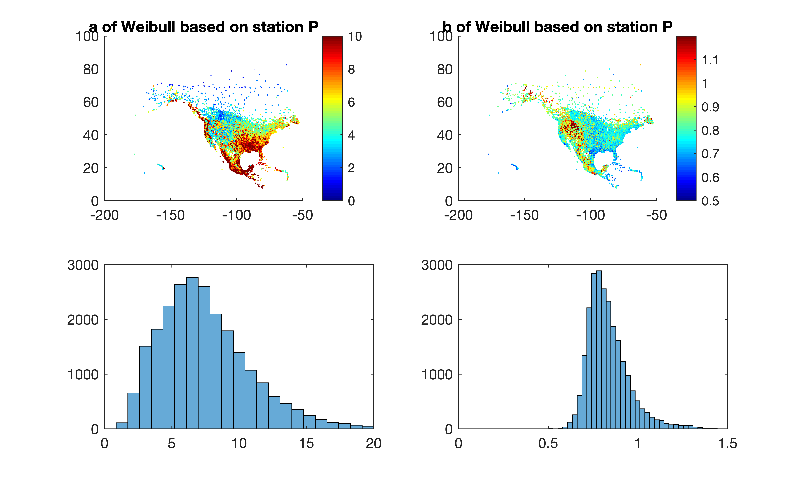
Weibull based on station data

Slide 5
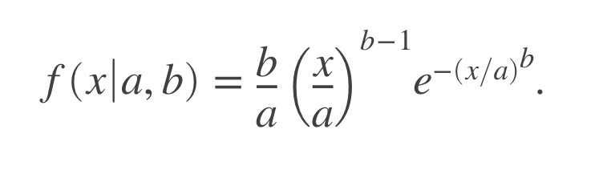
Weibull:
Negative log-likelihood changing with the two parameters
Three typical stations.
a: scale parameter
b: shape parameter
color: Weibull negative log-likelihood

Slide 6
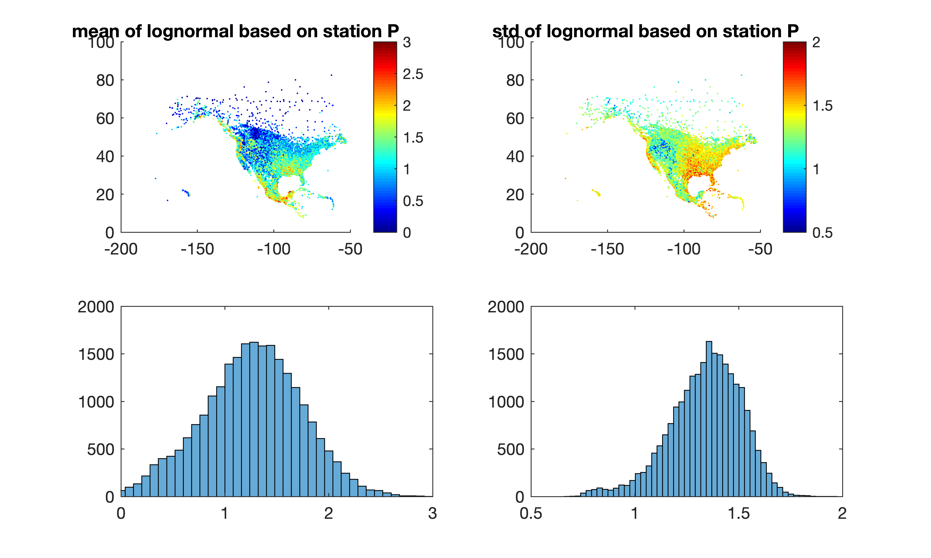
Lognormal based on station data

Slide 7
Lognormal:
Negative log-likelihood changing with the two parameters

Slide 8
Hellinger distance by comparing parametric distributions to ECDF
Two randomly selected stations with LL showing the best fitting
According to distance, Lognormal is better than Weibull than GG

